Slide 1

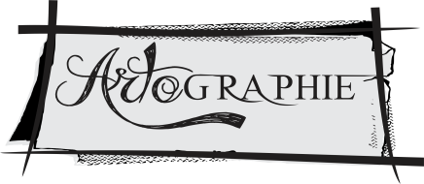
ARTOGRAPHIE
3D ARTIST
NIDHI AGRAWAL
9406862445

Slide 2
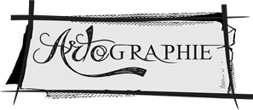
ABOUT
US
Artographie was formed in 2014 by Nidhi Agrawal, a passionate Artist & art enthusiast . Her constant endeavour and artistic approach helped her developing some new and rare 3D techniques in Paintings.
Although our region lacks 3D artist working on Street Art, Wall Art, Screw Art and lot of other art techniques. Hence we as Team Artographie are trying to develop the Modern Era of Art and giving a salute to upcoming and growing artists.

Slide 3
We have an
Expert hand in
  Creating Art on almost every surface, using various art material.
  Creation of Permanent and Temporary art.
  Live/Studio based production for 3D Art and pasting on surface at event location.
  On Demand live on location performance for unforgettable experience of customers or clients.

Slide 4
WHAT
WE CAN MAKE
Hand Painted Shoe Art
Hand Painted T-shirts
Screw Art
Line Art
Switch Board Art
3D Wall Art
3D Floor Art
3D Epoxy Art

Slide 5
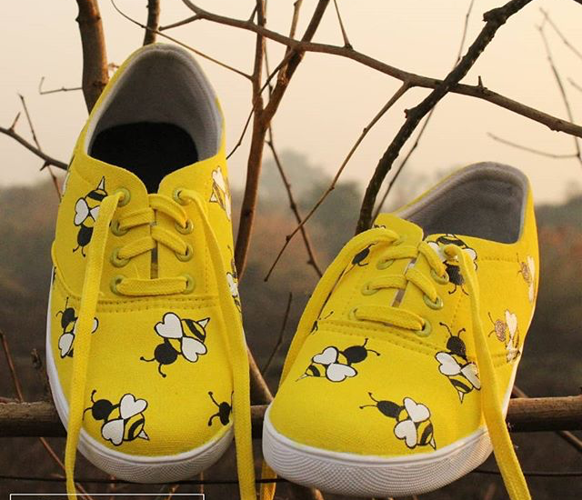
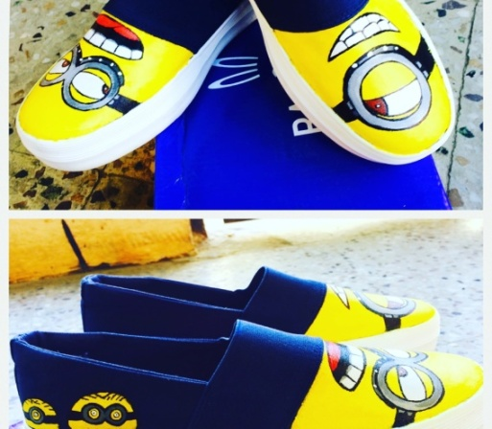
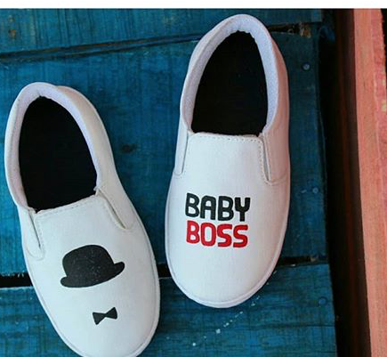
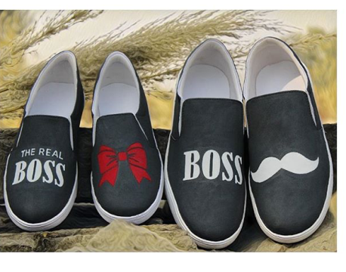
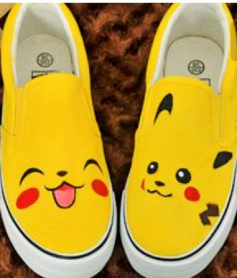
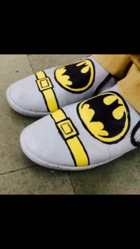
HANDPAINTED SHOE ART
Canvas shoes painted beautifully, with an attractive design customized as per your demand.
Washable, with gentle care.

Slide 6
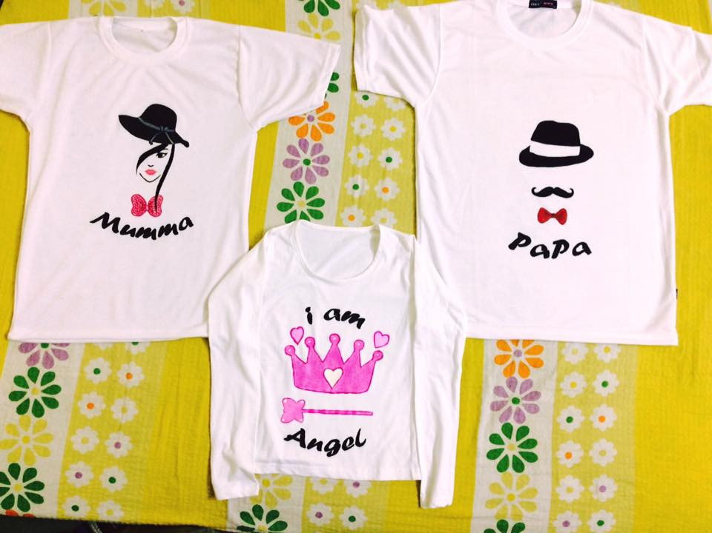
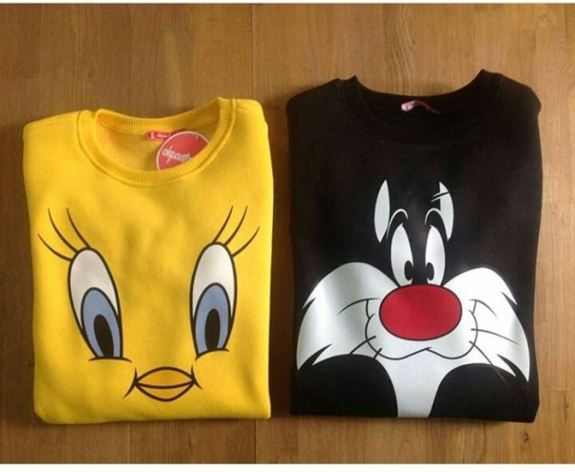
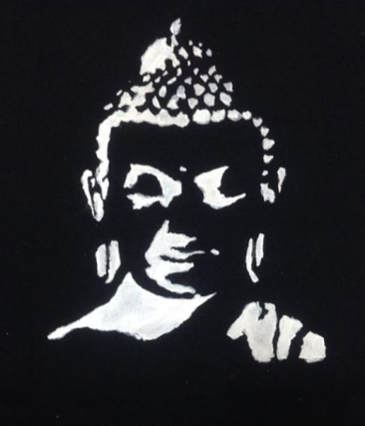
HANDPAINTED TSHIRTS
Can be painted as per demand on cotton t-shirts using various colour medium creating a attractive yet elegant wearable tee.
It is washable but gently & without Brushing.

Slide 7
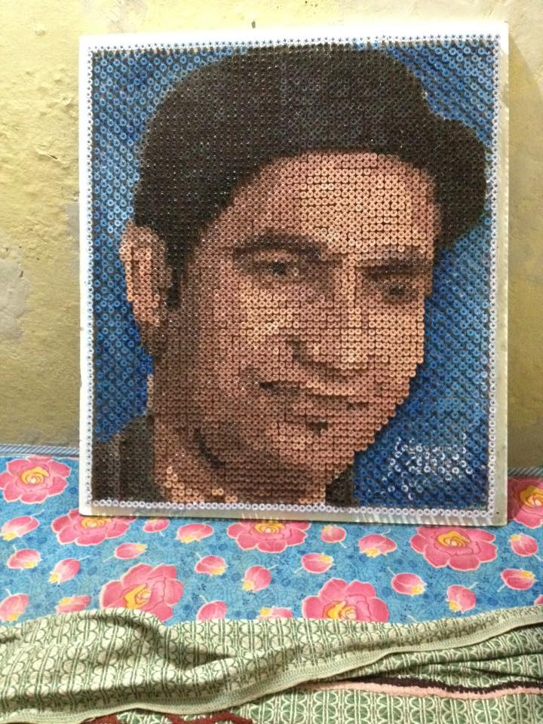
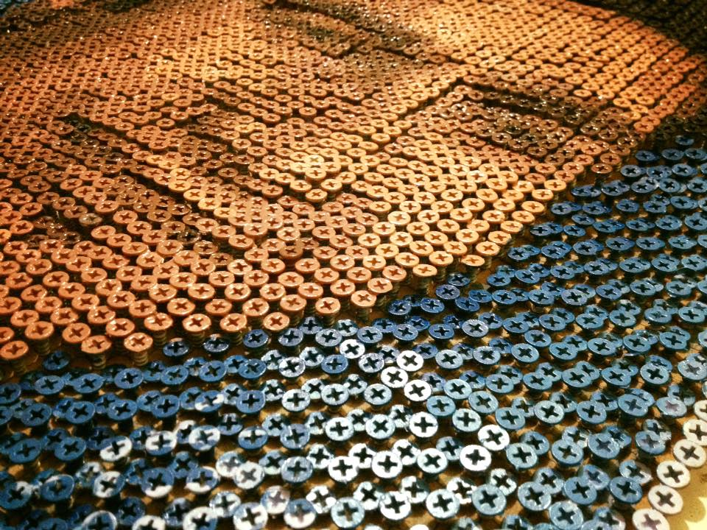
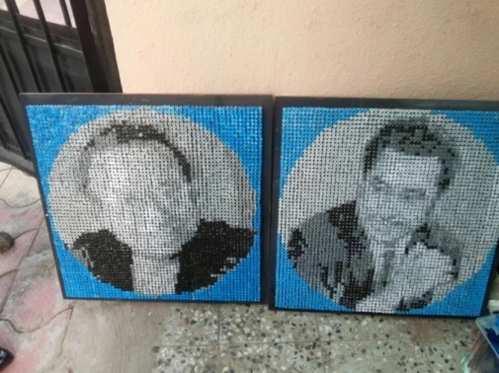
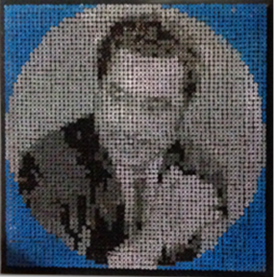
SCREW ART
An astonishing and creative art made on screws / nails
Can be customized . Amazing portraits or abstracts can be painted ,
on a frame full of nails/ screws a must see, very different and uncommon artwork .

Slide 8
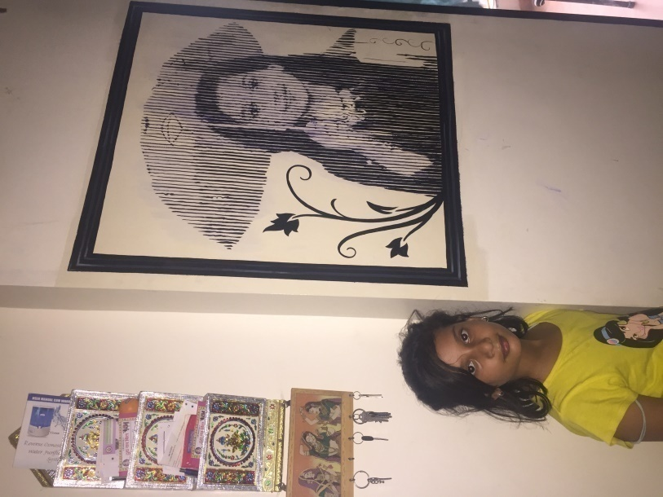
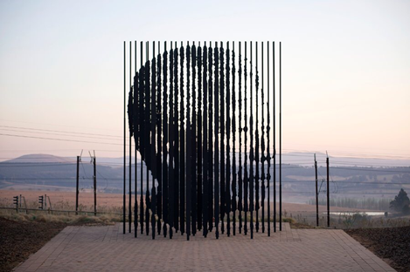
LINE ART
Created with simple lines, steels on wall or frame .
any picture can be created.
Again one of the most uncommon kind of art and specialty of Artographie.

Slide 9
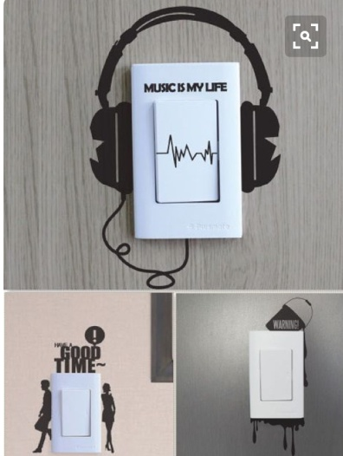
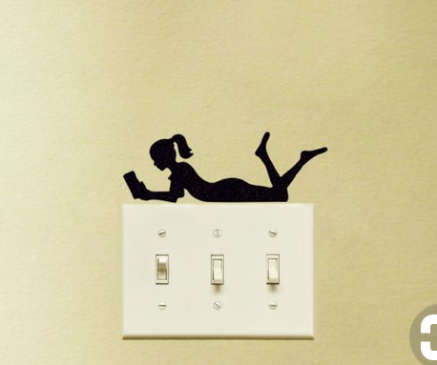
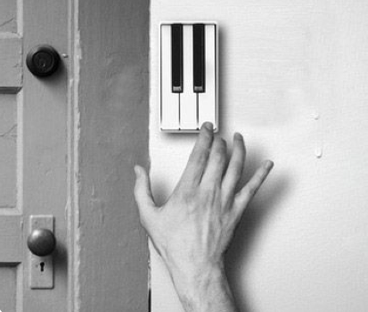
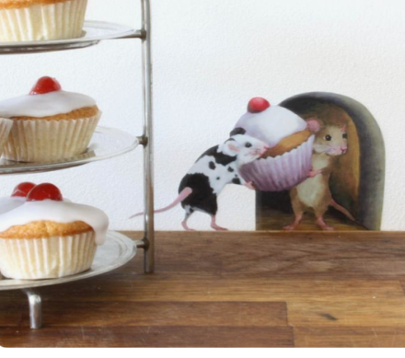

SWITCH BOARD ART
Created on wall, near switch panel which adds a very stylish look to the wall making your wall speak.
Painted with colours which are permanent .

Slide 10
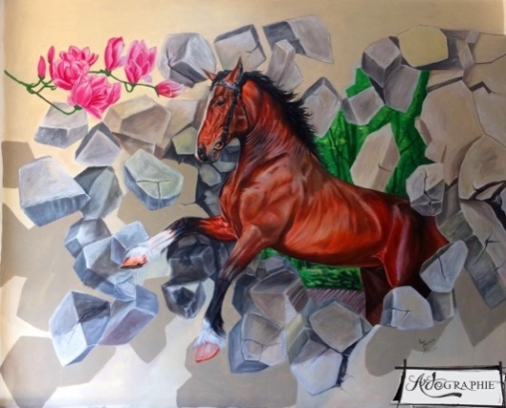
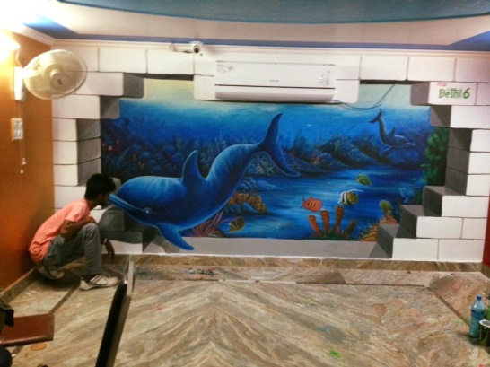
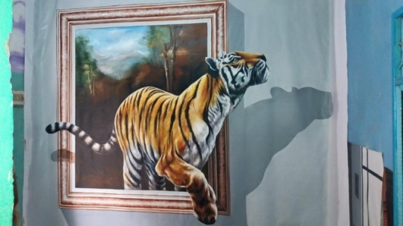
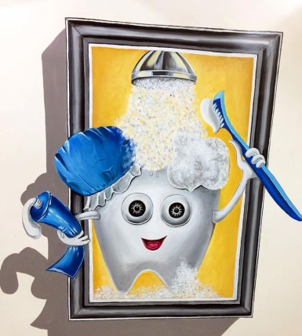
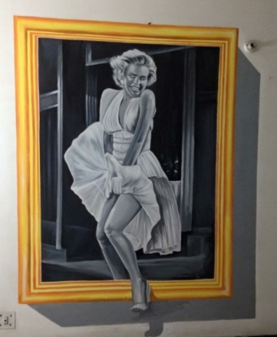
3D WALL ART
It is Painted on wall to create an amazing 3d experience. Its difficult for a person to judge if it is real or painting, in the camera view one can stand with the painting like a real thing, place or whatever is painted.
permanent colour is used.

Slide 11
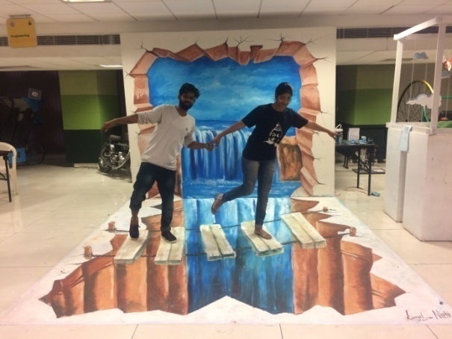
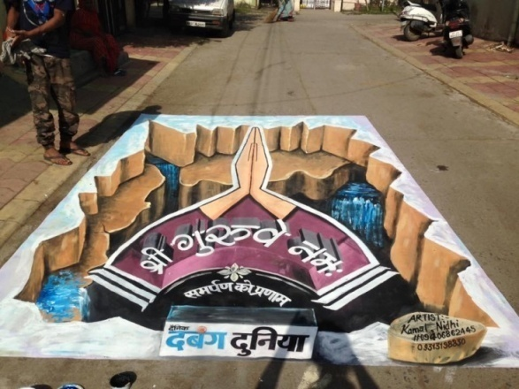
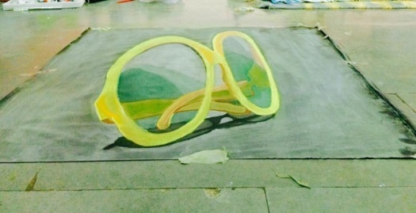
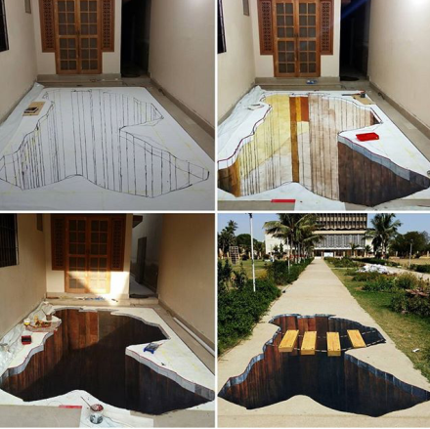
3D FLOOR ART
It is made on floor with 3d experience.
It is made with acrylic colors, chalk pastels colors which is permanent.
This art you can see with the camera lens only, without lens it would be distorted image.
This art can be used for product promotions, entertainment etc.

Slide 12
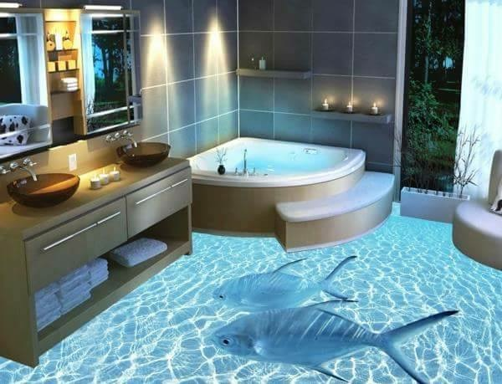
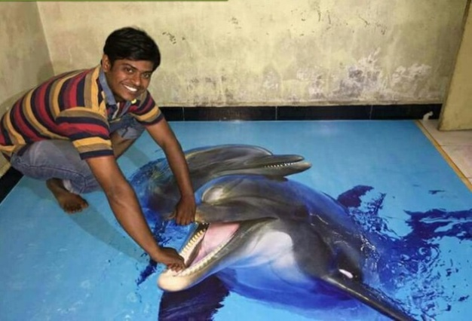
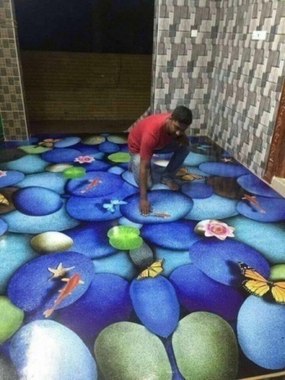
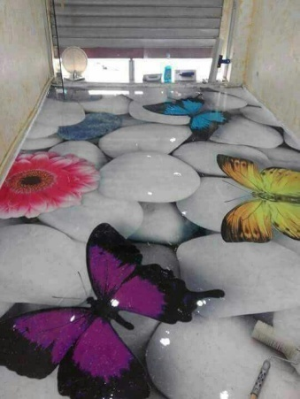
3D EPOXY ART
It is made on floors with chemicals.
You can customize whatever design you want.
It is permanent on floors which is durable for approx 8 years.

Slide 13
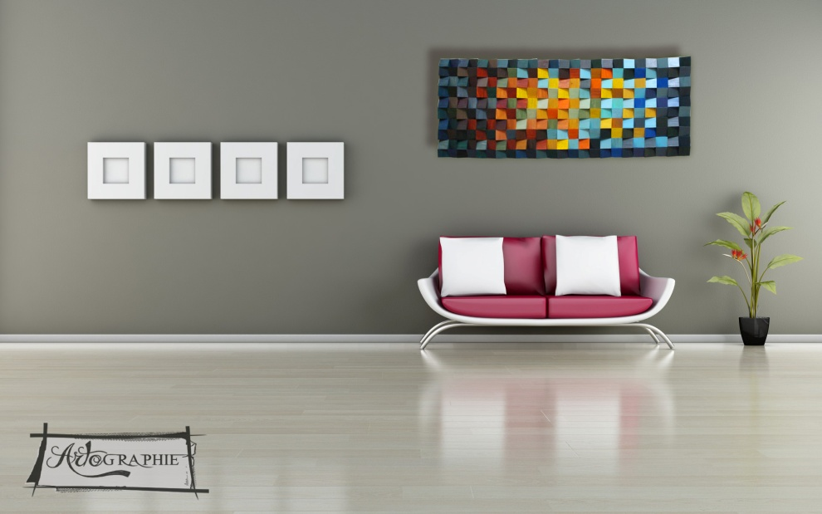
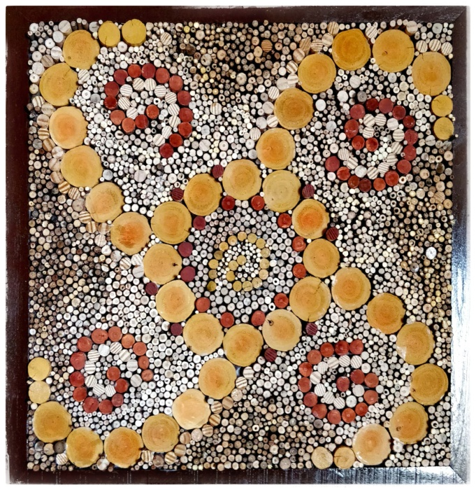
WALL ART

Slide 14
THANK YOU

